Slide 1
Wireless and Mobile Network

Slide 2
Wireless and Mobile network
Background:
# wireless (mobile) phone subscribers now exceeds # wired phone subscribers!
# wireless Internet-connected devices equals # wireline Internet-connected devices
laptops, Internet-enabled phones promise anytime untethered Internet access
two important (but different) challenges
wireless: communication over wireless link
mobility: handling the mobile user who changes point of attachment to network

Slide 3






















Elements of a wireless network
wireless hosts
laptop, smartphone
run applications
may be stationary (non-mobile) or mobile
wireless does not always mean mobility
network
infrastructure

Slide 4

Elements of a wireless network
base station
typically connected to wired network
relay - responsible for sending packets between wired network and wireless host(s) in its “area”
e.g., cell towers, 802.11 access points
network
infrastructure

Slide 5
Elements of a wireless network
wireless link
typically used to connect mobile(s) to base station
also used as backbone link
multiple access protocol coordinates link access
various data rates, transmission distance
network
infrastructure

Slide 6
Elements of a wireless network
infrastructure mode
base station connects mobiles into wired network
handoff: mobile changes base station providing connection into wired network
network
infrastructure

Slide 7
Elements of a wireless network
ad hoc mode
no base stations
nodes can only transmit to other nodes within link coverage
nodes organize themselves into a network: route among themselves

Slide 8
Wireless network taxonomy
single hop
multiple hops
host connects to
base station (WiFi,
WiMAX, cellular)
which connects to
larger Internet
host may have to
relay through several
wireless nodes to
connect to larger
Internet: mesh net
infrastructure
(e.g., APs)
no base station, no
connection to larger
Internet. May have to
relay to reach other
a given wireless node
MANET, VANET
no
infrastructure
no base station, no
connection to larger
Internet (Bluetooth,
ad hoc nets)

Slide 9
Wireless Link Characteristics (1)
important differences from wired link ….
decreased signal strength: 무선 전파는 신호의 세기가 거리에 따라 급격하게 감소
interference from other sources: 같은 주파수 대역을 공유하는 기술들끼리는 서로 간섭 현상을 일으킴
다중경로전파(multipath propagation): 무선 신호는 신호를 반사하는 어떤 물체(유리 등)를 만나면 반사되어 다중 경로로 전파될 수 있음

Slide 10

Wireless network characteristics (2)
Multiple wireless senders and receivers create additional problems (beyond multiple access):
A
B
C
C
A’s signal
strength
C’s signal
strength
B
A
space
Hidden terminal problem
B, A hear each other
B, C hear each other
A, C can not hear each other means A, C unaware of their interference at B
Signal attenuation:
B, A hear each other
B, C hear each other
A, C can not hear each other interfering at B

Slide 11
IEEE 802.11 Wireless LAN
802.11a
5-6 GHz range
up to 54 Mbps
802.11g
2.4-5 GHz range
up to 54 Mbps
802.11n: multiple antennae
2.4-5 GHz range
up to 200 Mbps
802.11b
2.4-5 GHz unlicensed spectrum
up to 11 Mbps
all use CSMA/CA for multiple access
all have base-station and ad-hoc network versions

Slide 12
802.11 LAN architecture
The IEEE 802.11 architecture consists of several components
BSS(Basic Service Set)
Basic building block of an IEEE 802.11 LAN
A set of stations that have successfully synchronized
BSA(Basic Service Area)
The area containing the members of a BSS
IBSS(Independent BSS)
STAs are able to communication directly (ad hoc network)
DS(Distribution System)
To interconnect BSSs
ESS(Extended Service Set)
An ESS is the union of the BSSs connected by a DS

Slide 13

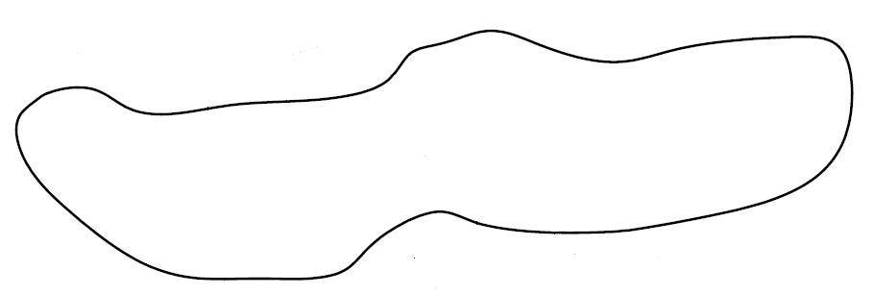
802.11 LAN architecture
Non-802.11 network
DS : Distribution System
DSS : Distribution System Service
STA : Station
BSS : Basic Service Set
ESS : Extended Service Set
AP : Access Point
STA
STA
Portal
DSS
STA
IBSS
AP
DS
DSS
DSS
AP
AP
STA
STA
STA
STA
BSS
BSS
ESS

Slide 14


802.11: passive/active scanning
BBS 1
BBS 1
BBS 2
BBS 2
1
AP 2
1
1
AP 1
2
2
AP 1
AP 2
3
2
3
4
H1
H1
passive scanning:
beacon frames sent from APs
association Request frame sent: H1 to selected AP
association Response frame sent from selected AP to H1
active scanning:
Probe Request frame broadcast from H1
Probe Response frames sent from APs
Association Request frame sent: H1 to selected AP
Association Response frame sent from selected AP to H1

Slide 15
802.11: Channels, association
802.11b: 2.4GHz-2.485GHz spectrum divided into 11 channels at different frequencies
AP admin chooses frequency for AP
interference possible: channel can be same as that chosen by neighboring AP!
host: must associate with an AP
scans channels, listening for beacon frames containing AP’s name (SSID) and MAC address
selects AP to associate with
may perform authentication
will typically run DHCP to get IP address in AP’s subnet

Slide 16
802.11: Channels, association
Scanning
Authentication
Association
STA
AP
Scanning
Active or passive
……
Association Request Format
Capability
Listen Interval
SSID | ‘nespot’
Supported rates
…
Authentication Request
Association Response Format
Capability
Status Code | 0(16 bit)
Association ID | (int)16bit
Supported rates
…
Authentication Response
Association Request
Association Response

Slide 17


802.11: Handoff procedure
Association
Reassociation
Disassociation
AP
AP
STA
STA
STA
STA
BSS
BSS
ESS

Slide 18
802.11: Reassociation
The reassociation service is invoked to move a current association from one AP to another
STA
AP
Association
Scanning
……
Authentication Request
New AP
Authentication Response
Reassociation Request
Reassociation Response

Slide 19
Super frame architecture
PCF(Point Coordination Function)
Optional access method
Real-time traffic
DCF(Distribution Coordination Function)
Basic medium access protocol
Non-real-time traffic
Super Frame
B
Contention period
DCF
B
or
Super Frame
Contention-Free Period(CFP)
B
PCF
Contention period
DCF
B

Slide 20
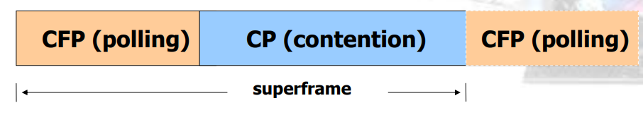
Super frame architecture
AP는 DCF와 PCF 구간을 조정해서 경쟁구간과 비경쟁구간을 교대로 반복(필요시 PCF 구간 사용)
Beacon signal
AP에 의해서 주기적으로 발생
타이밍 정보를 관리 중인 BSS안의 노드들에게 알려주기 위함
PCF를 알려주기 위해 사용하며 노드들은 beacon을 통해 경쟁구간인지 비경쟁구간인지 구분
DCF
Station 간 경쟁에 의한 매체 사용 제어
CSMA/CA 기반
Best effort basis– no guaranteed service
PCF
비경쟁 서비스
AP에 의한 Polling 방식으로 매체 사용권 제거
Time Bounded Services 제공
낮은 전송 지연
음성, 비디오

Slide 21




IEEE 802.11: multiple access
avoid collisions: 2⁺ nodes transmitting at same time
802.11: CSMA - sense before transmitting
don’t collide with ongoing transmission by other node
802.11: no collision detection!
difficult to receive (sense collisions) when transmitting due to weak received signals (fading)
can’t sense all collisions in any case: hidden terminal, fading
goal: avoid collisions: CSMA/C(ollision)A(voidance)
A
B
C
C
B
A’s signal
strength
C’s signal
strength
A
space

Slide 22
IEEE 802.11 MAC Protocol: CSMA/CA
802.11 sender
1 if sense channel idle for DIFS(DCF inter frame space) then
transmit entire frame (no CD)
2 if sense channel busy then
start random backoff time
timer counts down while channel idle
transmit when timer expires
if no ACK, increase random backoff interval, repeat 2
802.11 receiver
- if frame received OK
return ACK after SIFS(shortest inter frame space) (ACK needed due to hidden terminal problem)
sender
receiver
DIFS
data
SIFS
ACK

Slide 23
Avoiding collisions (more)
idea: allow sender to “reserve” channel rather than random access of data frames: avoid collisions of long data frames
sender first transmits small request-to-send (RTS) packets to BS using CSMA
RTSs may still collide with each other (but they’re short)
BS broadcasts clear-to-send CTS in response to RTS
CTS heard by all nodes
sender transmits data frame
other stations defer transmissions
avoid data frame collisions completely
using small reservation packets!

Slide 24

Collision Avoidance: RTS-CTS exchange
A
B
AP
RTS(B)
RTS(A)
reservation collision
RTS(A)
CTS(A)
CTS(A)
DATA (A)
defer
time
ACK(A)
ACK(A)

Slide 25
DCF
A station must sense the medium before initiating the transmission of a packet
SlotTime은 BSS 내의 왕복지연 시간
IFS : Inter Frame Space
SIFS : Shortest IFS
PIFS : SIFS + slotTime
DIFS : SIFS + 2*slotTime
DIFS
SIFS
Contention Window
RTS
Data
Source
SIFS
SIFS
Time
CTS
ACK
DIFS
Destination
PIFS
Time
SIFS
Contention Window
Other
NAV
Time
slotTime

Slide 26
Priority Access
프레임의 중요도에 따라 IFS 에 차등을 둠
제어용 프레임은 상대적으로 IFS 를 작게 하여 대기 시간을 줄임
데이터 프레임, 관리 프레임을 보낼 때 : 비교적 큰 값인 DIFS
비경쟁구간 시작시 : 그 보다 작은 PIFS
ACK, CTS ACK, CTS 등의 제어 프레임을 보낼 때는 가장 작은 SIFS (Shortest SIFS )
By the use of IFS (Interframe Space)
SIFS (Short IFS) : ACK, CTS, 또는 fragment
PIFS (PCF IFS) : CFP 시작 시 priority access priority access 를 위하여 사용
DIFS (DCF IFS) : 데이터 프레임 또는 관리 프레임을 보낼 때 사용
SIFS < PIFS < DIFS

Slide 27

BackOff procedure for DCF
For providing Lower collision probability
The backoff time is decreased as long as the channel is idle
When the channel is busy, the backoff time is frozen
After the packet collides, the backoff time increases exponentially
DIFS
DIFS
DIFS
DIFS
Frame
STA1
Backoff
Defer
Frame
STA2
Defer
STA3
Frame
Defer
Frame
STA4
Defer
Frame
STA5
= Backoff
= Remaining Backoff
Back off time = Random * slotTime
(0 $≤$ Random$≤$ 2^{3+i} , where i = the number of collision, 0$≤\text{i}≤$5)

Slide 28
Point Coordination Function
Single access point controls access to the medium
based on polling, Time-bounded service
AP
STA
Poll
Data + Poll
Data + Poll + Ack
Poll + Ack
Data
Data + Ack
Ack
Null Function(no data)
Contention-Free Repetition Interval
Contention-Free Period(CFP)
PIFS
SIFS
SIFS
SIFS
PIFS
SIFS
Contention period
AP
Beacon
D1+poll
D2+ack
+poll
D3+ack
+poll
D4+poll
CF-End
STA
U1+ack
U2+ack
U4+ack
D : down stream
U : up stream
No response
Reset NAV
SIFS
SIFS
SIFS
NAV

Slide 29
802.11: advanced capabilities
power management
node-to-AP: “I am going to sleep until next beacon frame”
AP knows not to transmit frames to this node
node wakes up before next beacon frame
beacon frame: contains list of mobiles with AP-to-mobile frames waiting to be sent
node will stay awake if AP-to-mobile frames to be sent; otherwise sleep again until next beacon frame

Slide 30
Power Save Mode
Overview
If an STA does not have any packet, the STA notifies the AP with the PM and switches to PSM
When the STA is sleeping, the AP must buffer the packet
STA
AP
Management
Frame
Frame
Control
Power
Management
NULL Data (PM = 1)
1bit
Beacon
TIM(Traffic
Indication Map)
Beacon
Frame(body)
PS Poll
Data

Slide 31

802.11: mobility within same subnet
H1 remains in same IP subnet: IP address can remain same
switch: which AP is associated with H1?
self-learning (Ch. 5): switch will see frame from H1 and “remember” which switch port can be used to reach H1
BBS 1
H1
BBS 2

Slide 32
What is mobility?
spectrum of mobility, from the network perspective:
no mobility
high mobility
mobile wireless user,
using same access
point
mobile user, connecting/ disconnecting from network using DHCP.
mobile user, passing through multiple access point while maintaining ongoing connections (like cell phone)

Slide 33
Background of mobile IP
The IP addresses are designed to work with stationary hosts because part of the address defines the network to which the host is attached.
다양한 무선 통신 기술의 등장과 함께 이동성을 지원하는 단말의 출현
IP 네트워크에서 이동성 지원 필요성 증가
Subnet 환경이 바뀌더라도 IP 주소를 변경하지 않고 통신할 수 있도록 지원할 수 있는 기능이 필요

Slide 34
Addressing
IP 프로토콜을 이용하여 이동통신 서비스를 제공할 때 가장 중요한 문제
정지 호스트(Stationary Hosts): netid와 subnet 주소를 이용하여 패킷 전달 가능
이동 호스트(Mobile Hosts): 새로운 네트워크에 도착 시 주소 변경->위치 식별 불가
DHCP 이용, 새로운 주소 획득
문제점
데이터 전송 중 일 경우 전송 중단(IP 주소가 변경됨에 따라)

Slide 35
Components of mobile IP
Mobile IP has two addresses for a mobile host:
home address : 영구적인 주소
care-of address: 모바일 노드가 다른 네트워크에 접속했을 경우 변하는 주소
Agent
호스트의 이동으로 인한 주소 변경을 다른 곳에서 알지 못하게 하기 위함
즉, 변경한 것을 알지 못하더라도 정상적으로 데이터 송수신은 가능하게
홈에이전트(Home agent, HA): 홈 네트워크에 연결된 라우터
외부 or 방문 에이전스(Foreign agent, FA): 외지 네트워크에 연결된 라우터로 홈 네트워크로부터 받은 패킷을 해당 호스트에게 전달하는 역할을 함

Slide 36



Mobility: vocabulary
home network: permanent “home” of mobile
(e.g., 128.119.40/24)
home agent: entity that will perform mobility functions on behalf of mobile, when mobile is remote
wide area network
permanent address: address in home network, can always be used to reach mobile
e.g., 128.119.40.186

Slide 37
Mobility: more vocabulary
permanent address: remains constant (e.g., 128.119.40.186)
visited network: network in which mobile currently resides (e.g., 79.129.13/24)
care-of-address: address in visited network.
(e.g., 79,129.13.2)
wide area network
foreign agent: entity in visited network that performs mobility functions on behalf of mobile.
Correspondent or remote host: wants to communicate with mobile

Slide 38
Mobility: approaches
let routing handle it: routers advertise permanent address of mobile-nodes-in-residence via usual routing table exchange.
routing tables indicate where each mobile located
no changes to end-systems
let end-systems handle it:
indirect routing: communication from correspondent to mobile goes through home agent, then forwarded to remote
direct routing: correspondent gets foreign address of mobile, sends directly to mobile
not
scalable
to millions of
mobiles

Slide 39
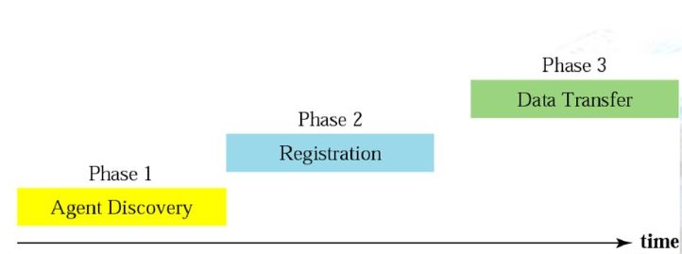
3 phase for communications
Communications between correspondent and mobile host

Slide 40
Phase 1: Agent Discovery
이동 노드가 현재 자신이 접속해있는 네트워크를 알기 위해 사용
홈 네트워크인지, 방문 네트워크인지
홈 또는 방문 에이전트들은 자신의 존재를 주기적으로 브로드캐스트하여 현재 이동 노드가 접속해있는 네트워크를 알림
Mobile IP extends ICMP Router Discovery as its primary mechanism for Agent Discovery

Slide 41
Phase 1: Agent Discovery
agent advertisement: foreign/home agents advertise service by broadcasting ICMP messages (typefield = 9)
H,F bits: home and/or foreign agent
R bit: registration required
Foreign agent only

Slide 42
Phase 2: Registration
이동 노드가 현재 방문 중인 네트워크를 홈 네트워크에 등록하는 절차
Used to
Request forwarding services when visiting a foreign network
Inform their home agent of their current care-of address
Renew a registration
Deregister when they return home

Slide 43
Phase 2: Registration
visited network
home network
1
2
wide area network
mobile contacts foreign agent on entering visited network
foreign agent contacts home agent home: “this mobile is resident in my network”
end result:
foreign agent knows about mobile
home agent knows location of mobile

Slide 44
registration example 1
visited network: 79.129.13/24
home agent
HA: 128.119.40.7
foreign agent
COA: 79.129.13.2
mobile agent
MA: 128.119.40.186
ICMP agent adv.
COA: 79.129.13.2
….
registration req.
registration req.
COA: 79.129.13.2
HA: 128.119.40.7
MA: 128.119.40.186
Lifetime: 9999
identification: 714
encapsulation format
….
COA: 79.129.13.2
HA: 128.119.40.7
MA: 128.119.40.186
Lifetime: 9999
identification:714
….
registration reply
HA: 128.119.40.7
MA: 128.119.40.186
Lifetime: 4999
Identification: 714
encapsulation format
….
registration reply
HA: 128.119.40.7
MA: 128.119.40.186
Lifetime: 4999
Identification: 714
….
time

Slide 45
registration example 2
visited network: 79.129.13/24
home agent
HA: 128.119.40.7
foreign agent
COA: 79.129.13.2
mobile agent
MA: 128.119.40.186
ICMP agent adv.
COA: 79.129.13.2
….
registration req.
By UDP using
the well-known port 434.
registration reply
time
FA의 중계없이 MN이 직접 HA에게 등록 요청

Slide 46

Data transfer via indirect routing
foreign agent receives packets, forwards to mobile
home agent intercepts packets, forwards to foreign agent
visited
network
home
network
3
wide area network
2
1
correspondent addresses packets using home address of mobile
4
mobile replies directly to correspondent
Correspondent node

Slide 47
Mobile IP: indirect routing
foreign-agent-to-mobile packet
packet sent by home agent to foreign agent: a packet within a packet
dest: 128.119.40.186
dest: 79.129.13.2
dest: 128.119.40.186
Permanent address: 128.119.40.186
Care-of address: 79.129.13.2
dest: 128.119.40.186
packet sent by correspondent

Slide 48
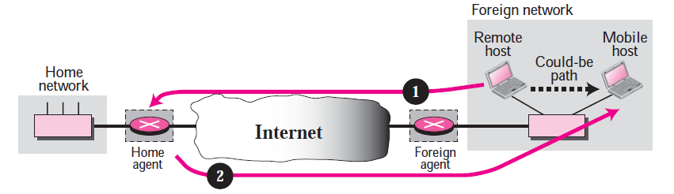
Indirect Routing: problems
Double crossing
Mobile host가 remote host (correspondent host)와 같은 네트워크로 이동했을 때 발생
같은 네트워크라 직접 통신이 가능하나 지속적으로 Home agent를 거쳐 데이터를 전송

Slide 49
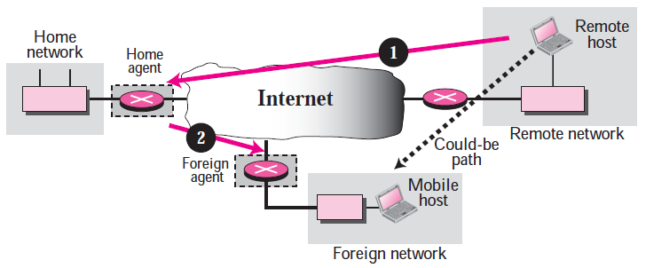
Indirect Routing: problems
삼각 라우팅 (Triangle routing)
모바일 노드가 리모트 노드와 같은 네트워크에 연결되어 있지 않는 경우 발생
Mobile node로 향하는 모든 패킷이 Home agent를 거치기 때문에 Home agent에 load가 증가
근본적으로는 home agent로 가는 모든 경로상에서 불필요한 오버헤드 증가
Mobile node의 위치에 따라 더 심각한 오버헤드를 야기할 수 있음

Slide 50


Mobility via direct routing
foreign agent receives packets, forwards to mobile
correspondent forwards to foreign agent
visited
network
home
network
3
1
2
4
correspondent requests, receives foreign address of mobile
mobile replies directly to correspondent

Slide 51




Mobility via direct routing: comments
overcome triangle routing problem
non-transparent to correspondent: correspondent must get care-of-address from home agent
what if mobile changes visited network?
3
1
2
4

Slide 52


Accommodating mobility with direct routing
anchor foreign agent: FA in first visited network
data always routed first to anchor FA
when mobile moves: new FA arranges to have data forwarded from old FA
foreign net visited
at session start
anchor
foreign
agent
wide area network
2
1
4
5
3
new
foreign
network
correspondent
agent
new foreign
agent
correspondent

Slide 53
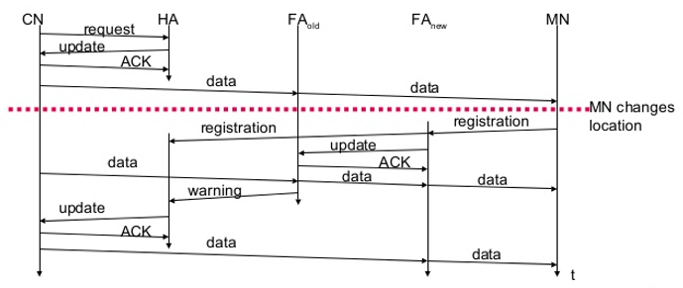
Binding cache
바인딩 요청 : CN은 MN의 위치를 알기 위해 HA에게 바인딩 요청
바인딩 업데이트 : HA는 MN의 현 위치를 알려줌
바인딩 확인응답 : 바인딩 업데이트 메시지를 수신한 후 응답 함
바인딩 경고 : MN에 대한 현재의 FA가 아니라면 바인딩 경고를 송신하여 MN의 위치가 변경되었음을 알리고 새롭게 바인딩 요청을 시작
이전 FA와 새로운 FA 모두에게서 데이터를 전달받을 수 있도록 하여 Data 손실을 줄임

Slide 54
P2P의 정보검색
분산 해시 테이블 (DHT, Distributed Hash Table)
시스템 내의 각 노드(node)들이 키 셋을 가지고 있는 분산 시스템
부하가 집중되지 않고 분산
큰 규모의 노드 관리
해시 테이블
Key = hash(original key)
Original Key
Hash
function
Key
Original Key | Key | Value
John Washington | 8962458 | 132-54-3570
Diana Louise Jones | 7800356 | 761-55-3791
Xiaoming Liu | 1567109 | 385-41-0902
Rakesh Gopal | 2360012 | 441-89-1956
Linda Cohen | 5430938 | 217-66-5609
……. |  | ………
Lisa Kobayashi | 9290124 | 177-23-0199

Slide 55
분산 해시 테이블: detail
DHT
Keyspace partitioning
분산된 peer들에게 키를 어떻게 배치시킬 것인가
Overlaynetwork
물리적 연결과 상관없이 완전하게 분산된 형태로 key의 위치를 찾아갈 수 있는 알고리즘을 제공
각 피어들은 key 값을 통해 데이터베이스에 쿼리(query)
데이터베이스는 키에 해당 하는 값 (value)를 리턴
쿼리에 해당 하는 값을 찾기 위해 적은 수의 메시지만 피어들 사이에 전송되어야 함
각 몇몇의 피어에 대한 정보를 가지고 있음

Slide 56
Assign key-value pairs to peers
Rule
Key-value 쌍은 가장 가까운 ID를 가지는 peer에 할당
가장 가까운 ID를 가지는 노드를 “다음 노드(successor)”라고 부름
e.g., ID space {0,1,2,3,…,63}
suppose 8 peers: 1,12,13,25,32,40,48,60
If key = 51, then assigned to peer 60
If key = 60, then assigned to peer 60
If key = 61, then assigned to peer 1

Slide 57














Circular DHT
each peer only aware of immediate
successor and 이전노드(predecessor).
1
12
60
13
48
25
40
32
“overlay network”

Slide 58
Resolving a query
1
What is the value associated with key 53 ?
value
12
60
13
48
O(N) messages
on average to resolve
query, when there
are N peers
25
40
32

Slide 59
Circular DHT with shortcuts
1
value
What is the value for
key 53
12
60
13
48
25
40
32
each peer keeps track of IP addresses of predecessor, successor, short cuts.
reduced from 6 to 3 messages.

Slide 60
Peer churn
1
handling peer churn:
peers may come and go (churn)
each peer knows address of its two successors
each peer periodically pings its two successors to check aliveness
if immediate successor leaves, choose next successor as new immediate successor
3
15
4
12
5
10
8
example: peer 5 abruptly leaves
peer 4 detects peer 5’s departure; makes 8 its immediate successor
4 asks 8 who its immediate successor is; makes 8’s immediate successor its second successor.

